Slide 1


Flavours of Physics: Finding $τ^{−}→ μ^{−}$ $μ^{−}$ $μ^{+}$
Final Project Presentation
2015 Kaggle Featured prediction Competition
Host: CERN
資科所碩二 7110095012 黃皓偉
GitHub: https://github.com/HuangHW012/111_01_Machine_Learning

Slide 2
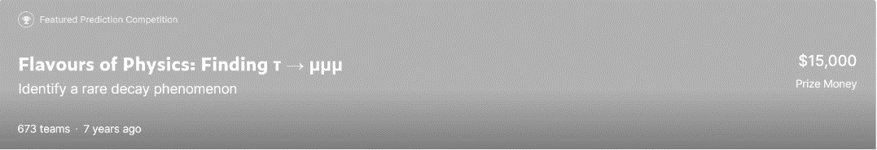
Description
Using real data from the LHCb experiment at the LHC to help physicists do in their analysis
Binary classification (signal vs. background)
=> supervised learning
2

Slide 3
Outline
Introduction
The meaning of this competition
Data Description and Model Design
Experimental Result
Conclusions
Reference
3

Slide 4
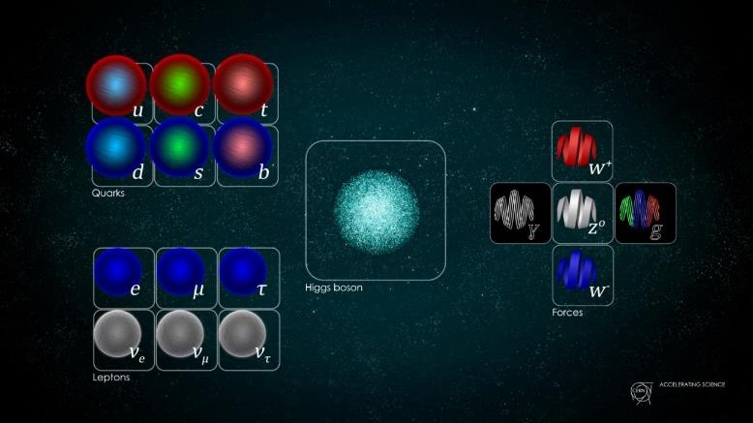
Introduction
fermion
I II III
boson
QED EWT QCD
leptons
The Standard Model
4

Slide 5
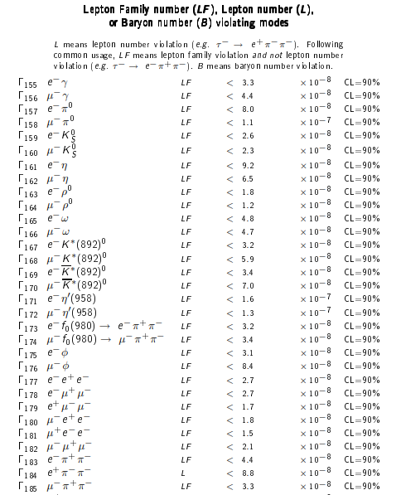
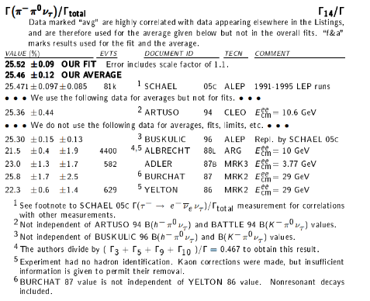
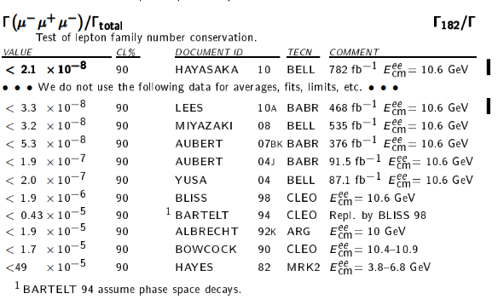
The meaning of this competition
SM: conservation of lepton number
Beyond the SM (BSM): lepton number violation (LNV)
5

Slide 6
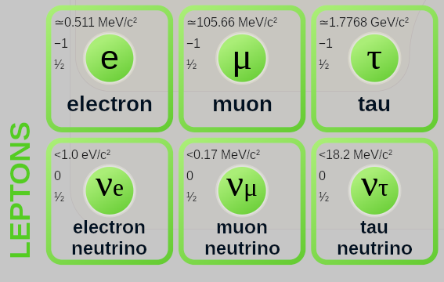


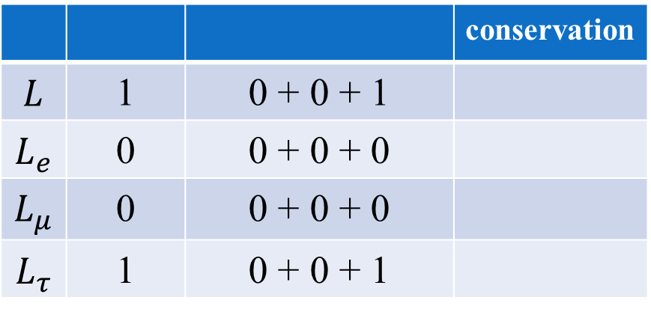
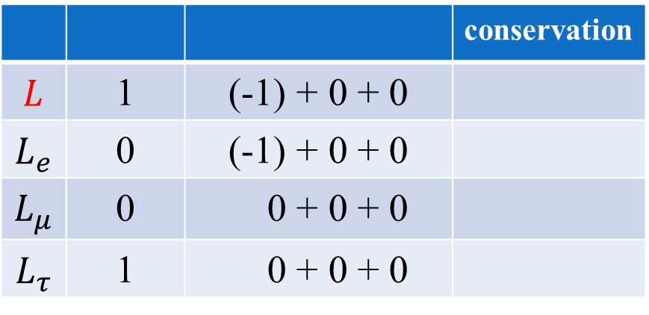

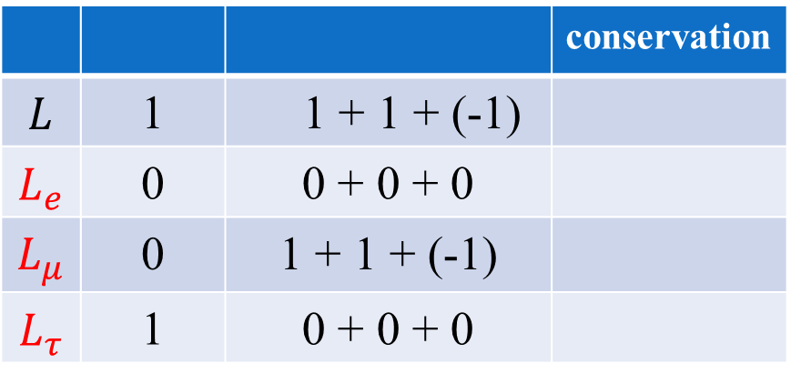
The meaning of this competition
L: lepton number violation
LF: lepton family violation
L
 |  |  | conservation
$$L$$ | 1 | (-1) + 0 + 0
$$L_{e}$$ | 0 | (-1) + 0 + 0
$$L_{μ}$$ | 0 | 0 + 0 + 0
$$L_{τ}$$ | 1 | 0 + 0 + 0
$$τ^{−}→ e^{+}+π^{−}+π^{−}$$

 |  |  | conservation
$$L$$ | 1 | 0 + 0 + 1
$$L_{e}$$ | 0 | 0 + 0 + 0
$$L_{μ}$$ | 0 | 0 + 0 + 0
$$L_{τ}$$ | 1 | 0 + 0 + 1
$$τ^{−}→ π^{−}+π^{0}+υ_{τ}$$






LF

 |  |  | conservation
$$L$$ | 1 | 1 + 1 + (-1)
$$L_{e}$$ | 0 | 0 + 0 + 0
$$L_{μ}$$ | 0 | 1 + 1 + (-1)
$$L_{τ}$$ | 1 | 0 + 0 + 0
$τ^{−}→μ^{−}+μ^{−}+$ $μ^{+}$




6

Slide 7
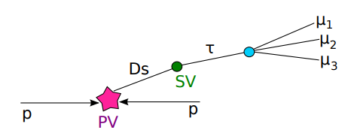
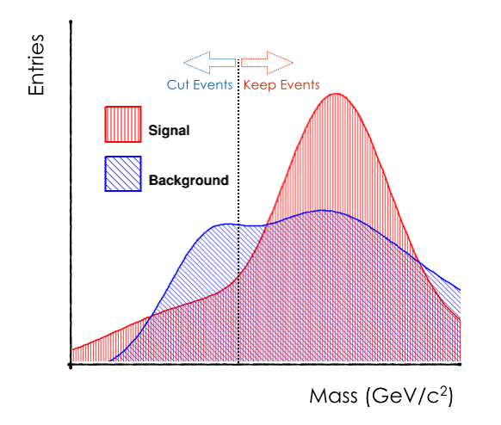
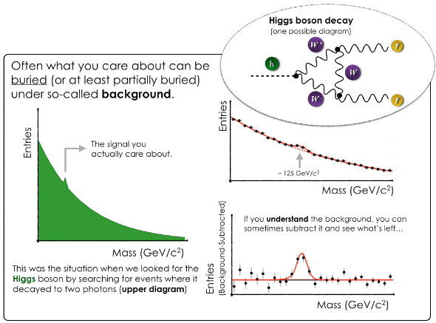
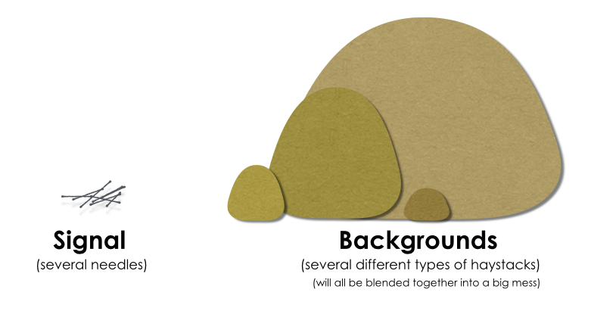
The meaning of this competition
Like Looking for a Needle in a Haystack
To provide a tool (classifier) to filter “signal” and ‘background’
7

Slide 8
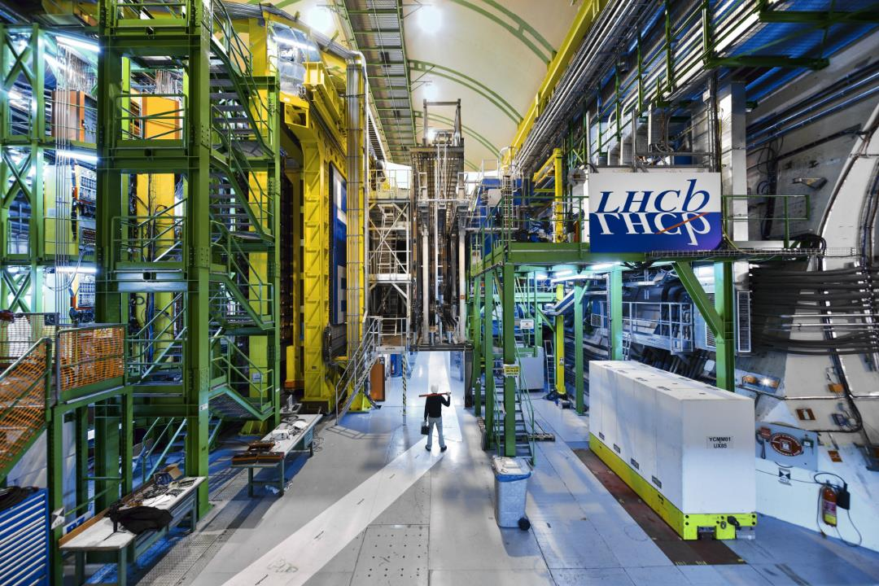
Data Description and Model Design
70%: new training set
(47287 records)
30%: new test set
(20266 records)
 | samples | features
training set | 67, 553 | 46 + 3
test set | 855, 819 | 46 + 0
agreement-test | 33, 1147 | 46 + 1
correlation-test | 5, 514 | 46 + 1
“production”, “mass”, “min_ANNmuon” only in training set
“weight” in agreement-test set
“mass” in agreement-test set
constraints
8

Slide 9
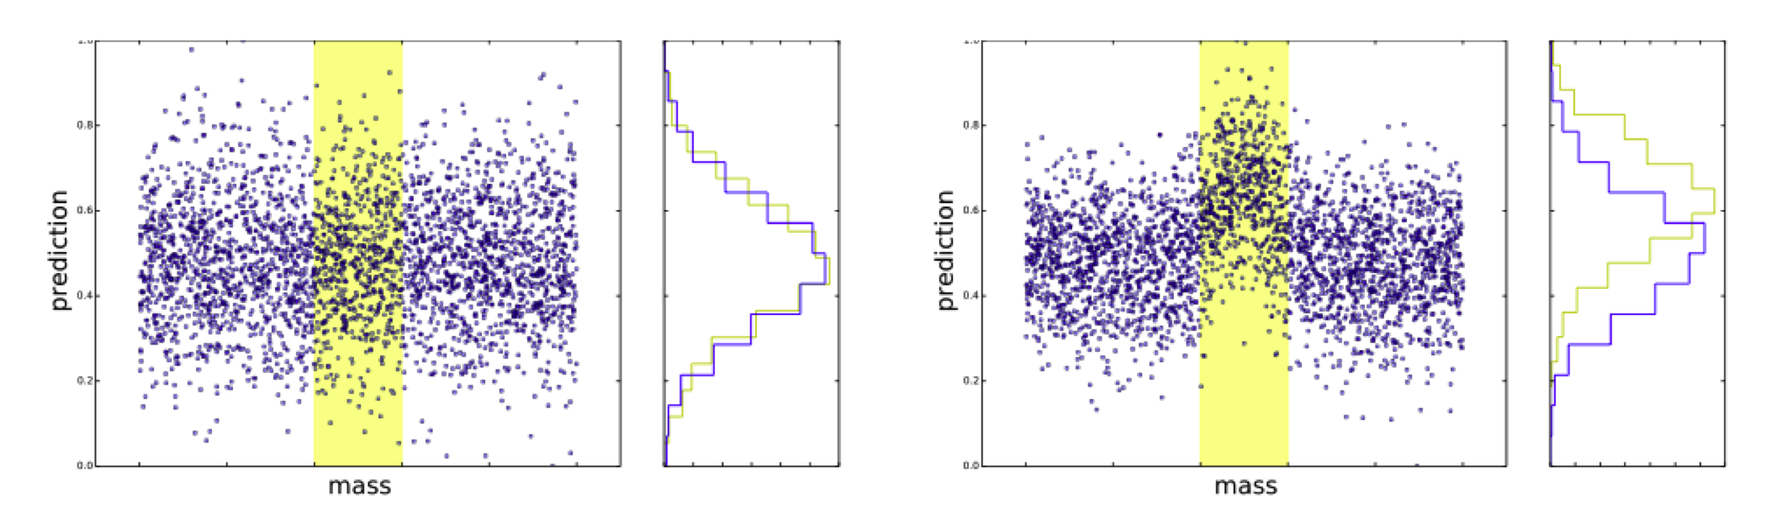
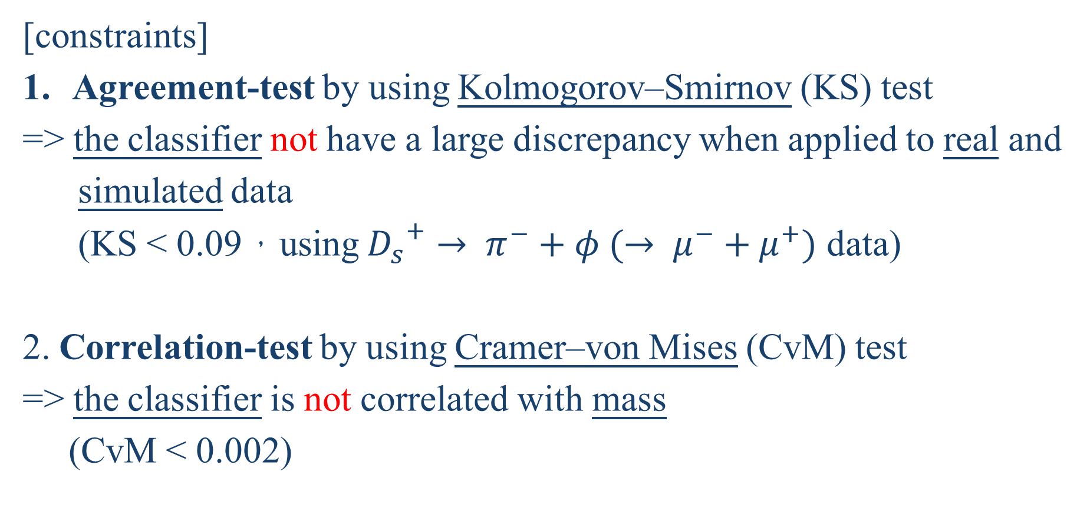
Data Description and Model Design
[constraints]
Agreement-test by using Kolmogorov–Smirnov (KS) test
=> the classifier not have a large discrepancy when applied to real and
simulated data
(KS < 0.09，using ${D_{s}}^{+}→ π^{−}+φ (→ μ^{−}+μ^{+})$ data)
2. Correlation-test by using Cramer–von Mises (CvM) test
=> the classifier is not correlated with mass
(CvM < 0.002)
9

Slide 10
Data Description and Model Design
Original features
features | features | features | features
FlightDistance | IP_p0p2 | ISO_SumBDT | p1_pt
FlightDistanceError | IP_p1p2 | p0_IsoBDT | p1_p
LifeTime | isolationa | p1_IsoBDT | p1_eta
IP | isolationb | p2_IsoBDT | p1_IP
IPSig | isolationc | p0_track_Chi2Dof | p1_IPSig
VertexChi2 | isolationd | p1_track_Chi2Dof | p2_pt
dira | isolatione | p2_track_Chi2Dof | p2_p
pt | isolationf | p0_pt | p2_eta
DOCAone | iso | p0_p | p2_IP
DOCAtwo | CDF1 | p0_eta | p2_IPSig
DOCAthree | CDF2 | p0_IP
SPDhits | CDF3 | p0_IPSig
1. p0, p1, p2: Final States Tracks
2. pt: Transverse Momentum
p: Momentum
4. eta: Pseudorapidity
5. IP: Impact parameter
6. IPSig: IP Significance
7. DOCA: Distance of Closest Approach
10

Slide 11
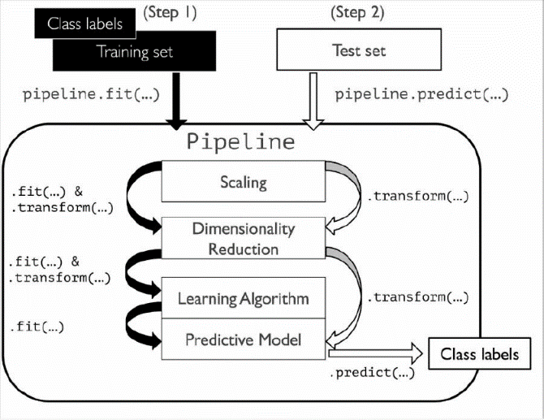
Data Description and Model Design
Data splitting
[flowchart]
Logistic Regression
Decision Tree
Random Forest
AdaBoost
XGBoost
Standardization
Accuracy
Precision
Sensitivity (Recall)
Specificity
F1 score
AUC
PCA
11

Slide 12
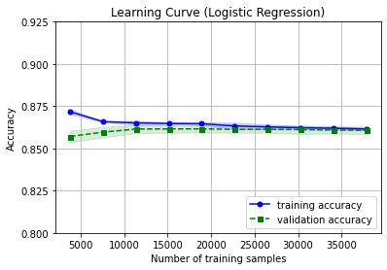
Experimental Results Logistic Regression
Using sklearn.linear_model.LogisticRegression
C = 1.0
Original features
 | Training | Test
Accuracy | 86.14 | 85.85
Precision | 87.42 | 87.16
Sensitivity | 90.58 | 90.38
Specificity | 79.00 | 78.55
F1 Score | 88.97 | 88.74
AUC | 84.79 | 84.47
12

Slide 13
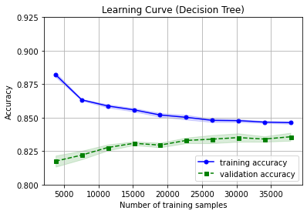
Experimental Results Decision Tree
Using sklearn.tree.DecisionTreeClassifier
max_depth = 6
Original features
 | Training | Test
Accuracy | 84.56 | 83.83
Precision | 87.81 | 87.02
Sensitivity | 87.05 | 86.73
Specificity | 80.55 | 79.17
F1 Score | 87.43 | 86.88
AUC | 83.80 | 82.95
13

Slide 14
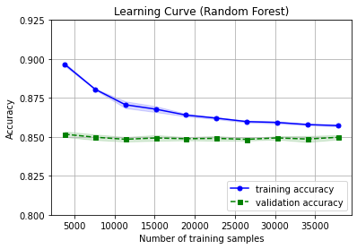
Experimental Results Random Forest
Using sklearn.ensemble.RandomForestClassifier
max_depth = 6
Original features
 | Training | Test
Accuracy | 85.60 | 84.91
Precision | 88.37 | 87.77
Sensitivity | 88.26 | 87.76
Specificity | 81.30 | 80.31
F1 Score | 88.32 | 87.77
AUC | 84.78 | 84.03
14

Slide 15
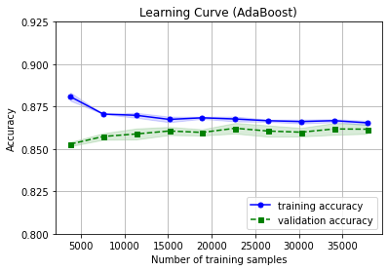
Experimental Results AdaBoost
Using sklearn.ensemble.AdaBoostClassifier
n_estimators = 50
Original features
 | Training | Test
Accuracy | 86.57 | 86.30
Precision | 88.30 | 87.91
Sensitivity | 90.17 | 90.20
Specificity | 80.77 | 80.02
F1 Score | 89.23 | 89.04
AUC | 85.47 | 85.11
15

Slide 16
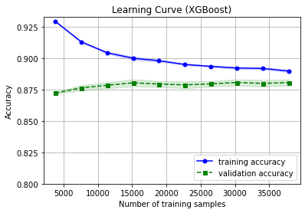
Experimental Results XGBoost
Using xgboost.XGBClassifier
max_depth = 6
Original features
 | Training | Test
Accuracy | 88.71 | 87.97
Precision | 89.96 | 89.32
Sensitivity | 91.96 | 91.43
Specificity | 83.47 | 82.39
F1 Score | 90.95 | 90.36
AUC | 8772 | 86.91
16

Slide 17
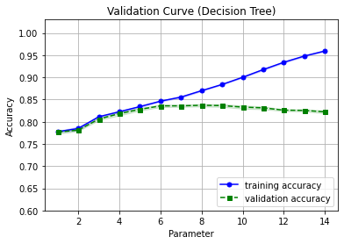
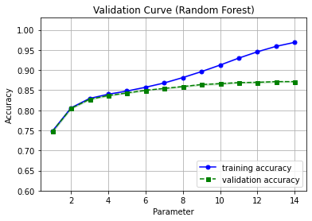
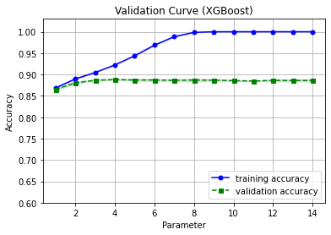
Experimental Results
[Hyperparameter]
Decision Tree
(max_depth)
Random Forest
(max_depth)
XGBoost (max_depth)
17

Slide 18
Experimental Results Comparison
[Training model without PCA]
Original features
Test | LR | DT | RF | AdaBoost | XGBoost
Accuracy | 85.85 | 83.83 | 84.91 | 86.30 | 87.97
F1 Score | 88.74 | 86.88 | 87.77 | 89.04 | 90.36
AUC | 84.47 | 82.95 | 84.03 | 85.11 | 86.91
Agreement |  |  |  |  | 
Correlation |  |  |  |  | 
18

Slide 19
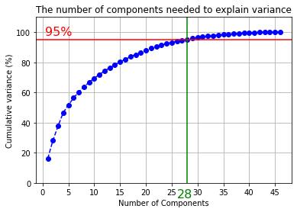
Experimental Results Principal Components Analysis (PCA)
Using sklearn.decomposition.PCA
19

Slide 20
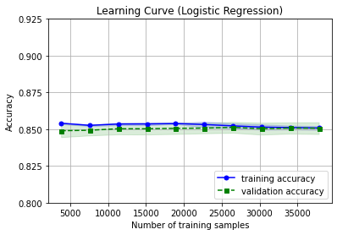
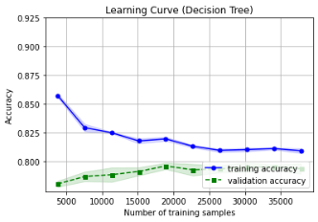
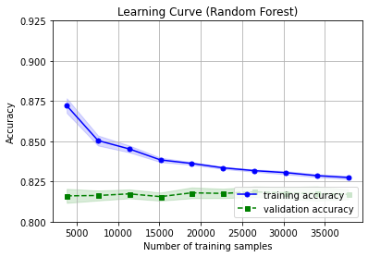
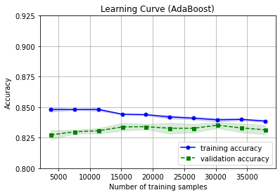
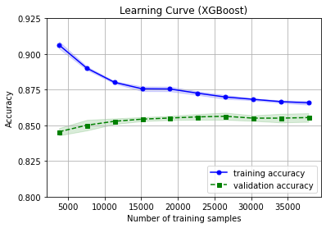
Experimental Results Comparison
[Training model with PCA]
Logistic Regression
Decision Tree
Random Forest
AdaBoost
XGBoost
20
Notes:
LR: default
DT: 6
RF: 6
Ada: 50
XGB: 2

Slide 21
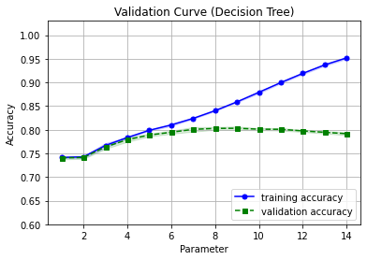
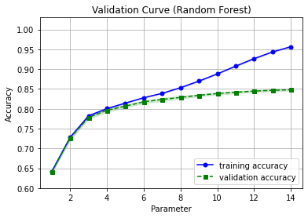
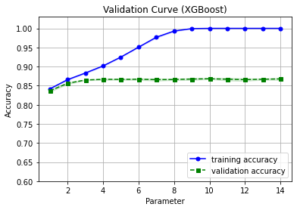
Experimental Results Comparison
[Training model with PCA]
Decision Tree
(max_depth)
Random Forest
(max_depth)
XGBoost (max_depth)
Notes:
LR: default

Slide 22
Experimental Results Comparison
[Training model with PCA]
Original features
Training | LR | DT | RF | AdaBoost | XGBoost
Accuracy | 85.08 | 81.12 | 82.64 | 83.63 | 86.47
Precision | 86.43 | 83.83 | 82.74 | 85.22 | 87.55
Sensitivity | 89.93 | 85.98 | 90.80 | 88.88 | 91.00
Specificity | 77.27 | 73.30 | 69.49 | 75.18 | 79.16
F1 Score | 88.15 | 84.89 | 86.58 | 87.01 | 89.24
AUC | 83.60 | 79.64 | 80.14 | 82.03 | 85.08
21

Slide 23
Experimental Results Comparison
[Training model with PCA]
Original features
Test | LR | DT | RF | AdaBoost | XGBoost
Accuracy | 84.80 | 79.57 | 81.46 | 83.22 | 85.38
F1 Score | 87.92 | 83.71 | 85.69 | 86.71 | 88.40
AUC | 83.31 | 77.88 | 78.85 | 81.53 | 83.89
Agreement |  |  |  |  | 
Correlation |  |  |  |  | 
22

Slide 24
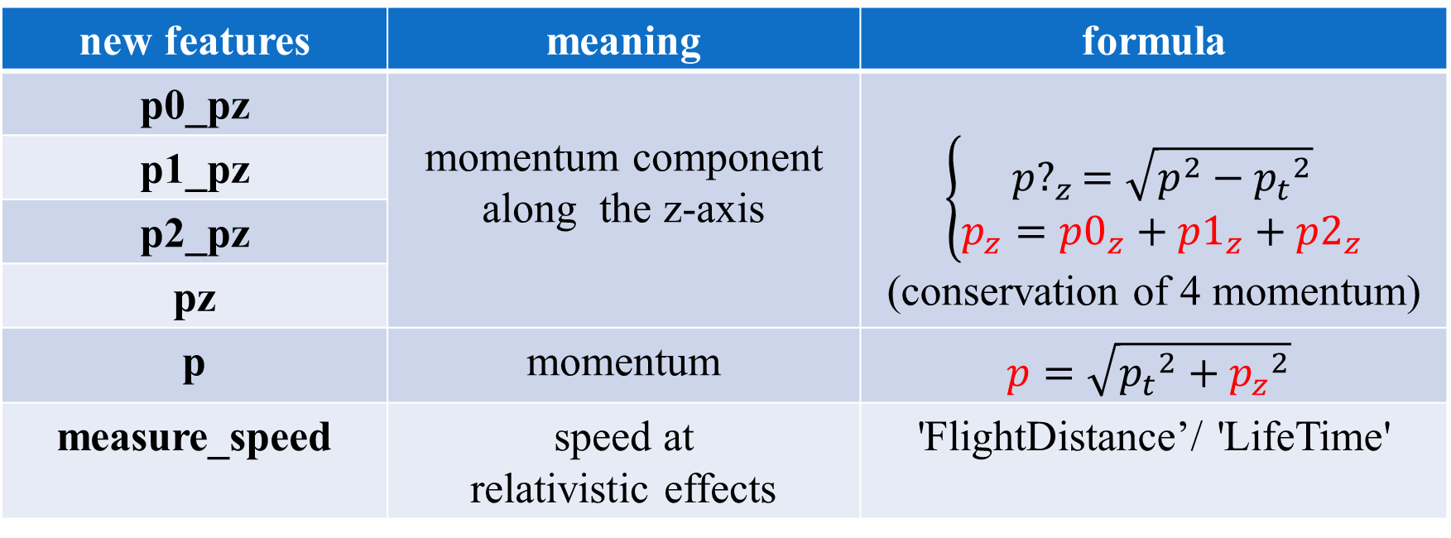
Add new features using physics formulas
Add new features
new features | meaning | formula
p0_pz | momentum component along the z-axis | $$\left\{\begin{aligned}{p?}_{z}=\sqrt{p^{2}−{p_{t}}^{2}} \\ p_{z}={p0}_{z}+{p1}_{z}+{p2}_{z}\end{aligned}\right.$$ (conservation of 4 momentum)
p1_pz
p2_pz
pz
p | momentum | $$p=\sqrt{{p_{t}}^{2}+{p_{z}}^{2}}$$
measure_speed | speed at relativistic effects | 'FlightDistance’/ 'LifeTime'
23

Slide 25
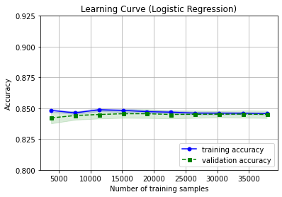
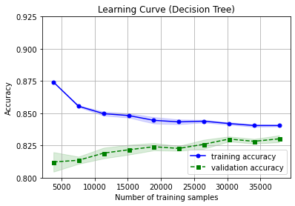
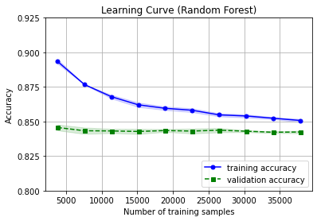
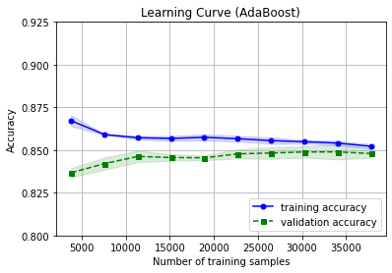
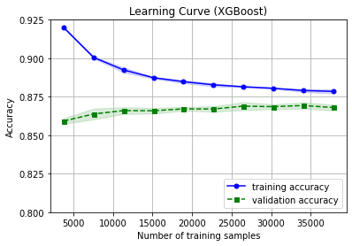
Experimental Results Comparison
[Training model without PCA]
Logistic Regression
Decision Tree
Random Forest
AdaBoost
XGBoost
24
Notes:
LR: default
DT: 6
RF: 6
Ada: 50
XGB: 2

Slide 26
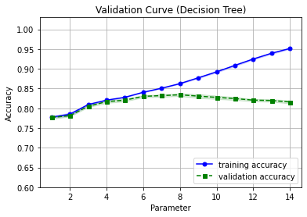
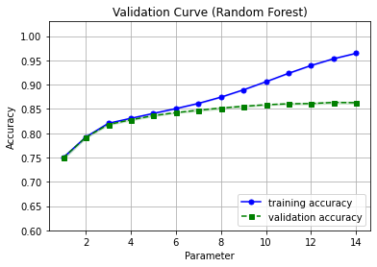
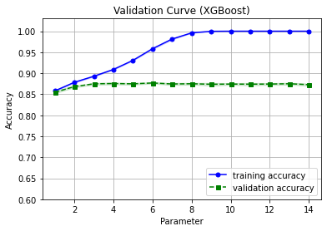
Experimental Results Comparison
[Training model without PCA]
Decision Tree
(max_depth)
Random Forest
(max_depth)
XGBoost (max_depth)
Notes:
LR: default

Slide 27
Experimental Results Comparison
[Training model without PCA]
Add new features
Training | LR | DT | RF | AdaBoost | XGBoost
Accuracy | 84.56 | 83.92 | 84.96 | 85.18 | 87.67
Precision | 85.90 | 86.90 | 88.10 | 87.12 | 89.27
Sensitivity | 89.71 | 87.06 | 87.43 | 89.16 | 90.95
Specificity | 76.28 | 78.86 | 80.99 | 78.77 | 82.40
F1 Score | 87.76 | 86.98 | 87.76 | 88.13 | 90.10
AUC | 82.99 | 82.96 | 84.21 | 83.97 | 86.67
25

Slide 28
Experimental Results Comparison
[Training model without PCA]
Add new features
Test | LR | DT | RF | AdaBoost | XGBoost
Accuracy | 84.23 | 82.97 | 84.10 | 84.52 | 86.50
F1 Score | 87.48 | 86.22 | 87.07 | 87.62 | 89.20
AUC | 82.69 | 81.92 | 83.28 | 83.22 | 85.34
Agreement |  |  |  |  | 
Correlation |  |  |  |  | 
26

Slide 29
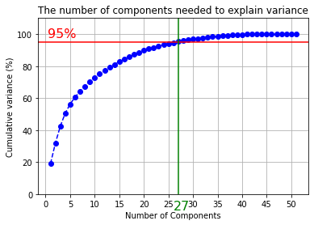
Data Description and Model Design
Principal Components Analysis (PCA)
27

Slide 30
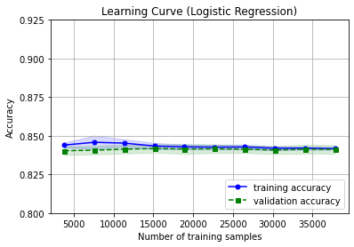
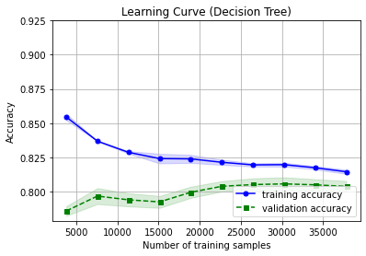
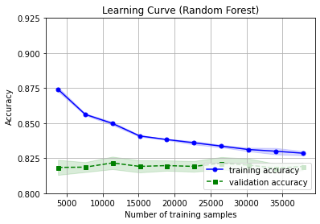
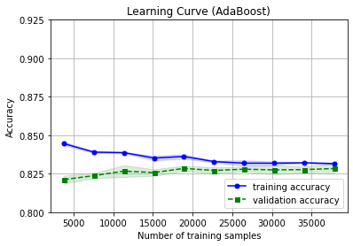
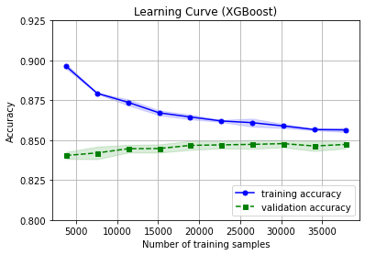
Experimental Results Comparison
[Training model with PCA]
Logistic Regression
Decision Tree
Random Forest
AdaBoost
XGBoost
28
Notes:
LR: default
DT: 6
RF: 6
Ada: 50
XGB: 2

Slide 31
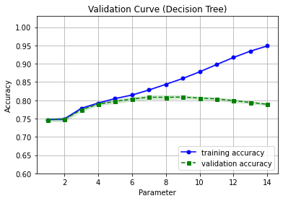


Experimental Results Comparison
[Training model with PCA]
Decision Tree
(max_depth)
Random Forest
(max_depth)
XGBoost (max_depth)
Notes:
LR: default

Slide 32
Experimental Results Comparison
[Training model with PCA]
Training | LR | DT | RF | AdaBoost | XGBoost
Accuracy | 84.18 | 81.17 | 82.71 | 83.16 | 85.58
Precision | 85.55 | 83.66 | 84.01 | 85.00 | 87.06
Sensitivity | 89.48 | 86.35 | 88.89 | 88.28 | 90.01
Specificity | 75.66 | 72.83 | 72.75 | 74.92 | 78.45
F1 Score | 87.47 | 84.98 | 86.38 | 86.61 | 88.51
AUC | 82.57 | 79.59 | 80.82 | 81.60 | 84.23
29

Slide 33
Experimental Results Comparison
[Training model with PCA]
Test | LR | DT | RF | AdaBoost | XGBoost
Accuracy | 84.00 | 79.70 | 81.57 | 82.76 | 84.64
F1 Score | 87.33 | 83.87 | 85.58 | 86.33 | 87.78
AUC | 82.36 | 77.93 | 79.41 | 81.09 | 83.20
Agreement |  |  |  |  | 
Correlation |  |  |  |  | 
30

Slide 34


Conclusions
XGBoost is the best model the other methods
PCA could not improve the model performance
Original features
Add new features
31

Slide 35


The Standard Model Lagrangian
32

Slide 36

Reference
Flavours of Physics: Finding $τ→ μ$ $μ$ $μ$ (2015 Kaggle)
The LHCb collaboration (CERN)
Sklearn
XGBoost
Nice explanation of particle physics
Introduction to Monte Carlo for Particle Physics Study
33

